Slide 1




Company Profile

Slide 2




Agenda
Poverty & hunger are curses.
Our aim: To generate employment and earn dignity & self-respect for our compatriots through profitable enterprises.
Mission
Improving Livelihood
Vision

Slide 3







OVERVIEW
Production Facilities spread over 30 different locations in Bangladesh, 4 in India and 2 in Nepal.
Directly employing 158,000 people
1.5 million people subsist on PRAN RFL Group
Exporting to over 145 countries of the world
100,000 contractual farmers
Best Exporter’s trophy 21 consecutive years
PRAN-RFL Started its journey in 1981

Slide 4
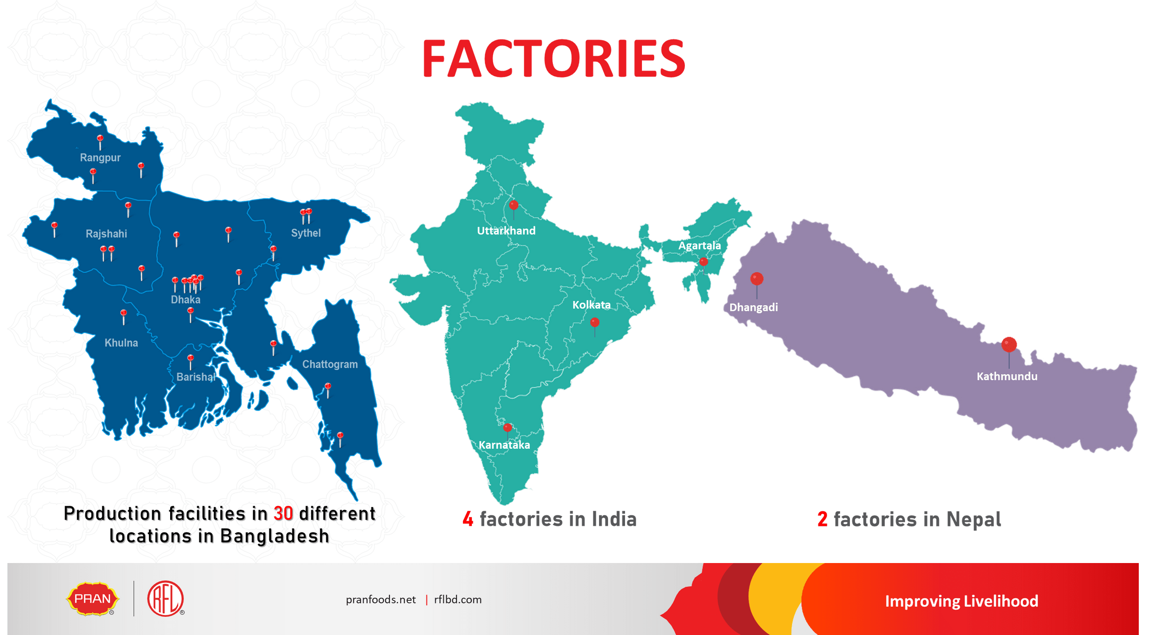

Slide 5

Area of Business
Poly & Non-woven Bags
Flexible Packaging
Food & Beverage
RMG
Plastic Houseware
Plastic Pipe And Fittings
Cast Iron
Cables
Electric Apparatus
Electronics
Footwear
Paints
Furniture
Metal Pipe
Bathroom Fittings
PVC Door & Accessories
Bicycle
Tableware
Kitchen Appliances
Cookware
Medical Device & Equipment
Apparel trims and accessories
Stationery
Cleaning Items
Lubricants
Adhesive & Chemicals
Toys
Luggage
Lift & Escalator
Fire Safety Equipment
Ready Mix Concrete
Retail Shops
Real Estate

Slide 6
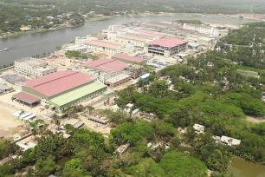



ABOUT THE BUSINESS
ABOUT OUR
Agenda
Advance Trims Solution BD Ltd (ATSBL) is a leading exporter of poly and non-woven shopping bags from Bangladesh, trusted by global retailers for quality, competitiveness, compliance, and sustainability
Began operation in Year 2010 as AllPlast Bangladesh Ltd. and converted to Year 2025 as ATSBL.
Recognized as Bangladesh’s #1 exporter in this category.
Equipped with state-of-the-art machinery, in-house tooling facilities, and a dedicated training center to continuously upskill our workforce.
Operating fully compliance-certified factories under ISO 9001, ISO 14001, BSCI, and GRS.
Driving innovation with a commitment to eco-friendly packaging solutions for a greener future.
AREA: 300,000 sqft.
MANPOWER: 2300+
EXPORT/Year: $ 50 M
CAPACITY: 30K MT POLY BAG
& 10K MT IN NON-WOVEN/Year

Slide 7
Product Portfolio
Agenda
Produce Bag on Roll
T-Shirt Bag/Knot Bag
Trash Bags
Pet Waste Management Bags
Compostable/Bio-degradable Bags
Zipper Poly Bag
Mailer Bag/Courier Bag
Soft Loop Handle Bag
Meat Bag / Flat Bag
Bottom/Side Sealing Bag
Bread Bag/Wicketer Bag
Sandwich Bag
Flower Bags
Flexible Packaging
Hot Stamping Foil
Heat Transfer Film
Disposable Hand Gloves
Mulching Film
Table Cover Sheets
Wrapping Film
POF Shrink Film
Tinsel Garden & Décor
Garments Poly
Non-Woven Fabric Roll
Non-Woven Collapsible Storage
Tote Bag/ Loop Handle Bags
Di Cut Bags
T Shirt Bags
Leader Bag
Sewing Bag
Drawstring Bag
Medical Gown
PP Spun bond Hydrophilic Fabric Roll
Thermal Dot Fuse Interlining

Slide 8
15
40+
Years in Business
ATSBL started its journey since 2010
Countries Exported
30000
10000
Tons yearly produced -Poly bags
Tons yearly produced
-Non-Woven bags

Slide 9



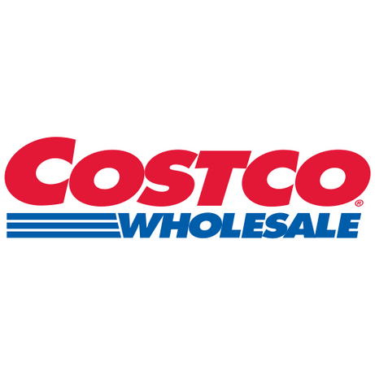





Our Valued Customer

Slide 10

What products we offer in ATSBL?

Slide 11

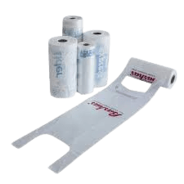
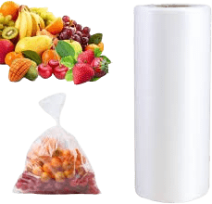
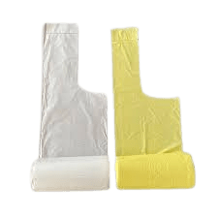
Product Portfolio -Poly
Produce Bag on Roll
Features
Good Strength Regular Usage Biodegradable Compostable Customized Size Up to 8 Colors Printing
Flat Bag
T-Shirt Bag
Star Sealed Bag

Slide 12
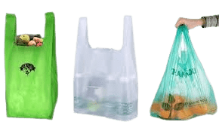
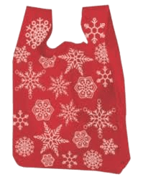
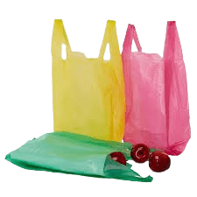
Product Portfolio -Poly
T-Shirt Bag
Features
Good Strength Regular Usage Biodegradable Compostable Customized Size Up to 8 Colors Printing

Slide 13
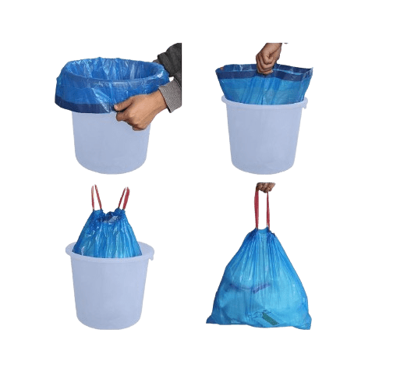
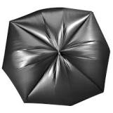
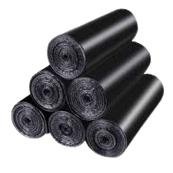
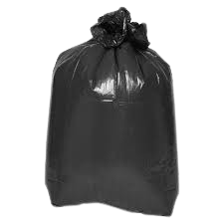
Product Portfolio -Poly
Trash/Garbage Bag
Features
Good Strength Regular Usage Biodegradable Compostable Customized Size Up to 8 Colors Printing
Draw-Tap Bags on Roll
Star Seal Bag
C/E Fold Bag
Flat

Slide 14
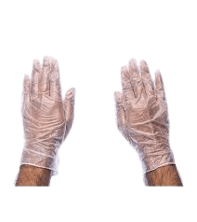
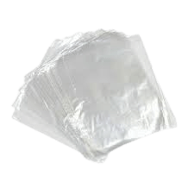
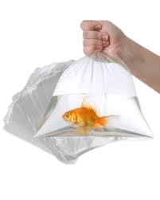
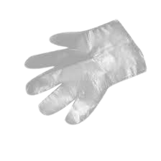
Product Portfolio -Poly
Butcher Bag / Meat Bag
Disposable Hand Gloves
Features
Good Strength Regular Usage Biodegradable Compostable Low thickness Customized Size
Features
Good Strength Regular Usage Biodegradable Compostable Easy to Use Non-Sticky

Slide 15
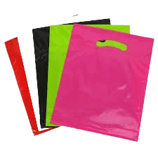
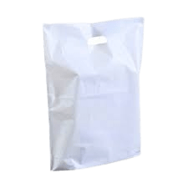

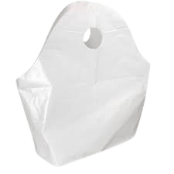
Product Portfolio -Poly
Fashionable Bags
Features
Good Strength Regular Usage Biodegradable Compostable Customized Size Aesthetic Design Up to 8 Colors Printing
Di-Cut
Patch Handle
Loop Handle Bag
Wave Top

Slide 16
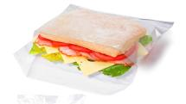
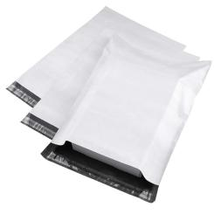
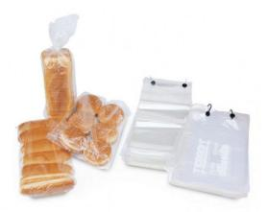

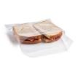
Product Portfolio -Poly
Mailer Bag/Courier Bag
Bread Bags/Wicketer Bag
Sandwich Bags
Features
Good Strength Regular Use Biodegradable Customized Size Aesthetic Design Up to 8 Colors Printing
Features
Good Strength Regular Use Biodegradable Customized Size Aesthetic Design Up to 8 Colors Printing
Features
Good Strength Regular Use Biodegradable Customized Size Aesthetic Design Up to 8 Colors Printing

Slide 17
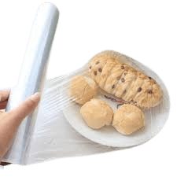
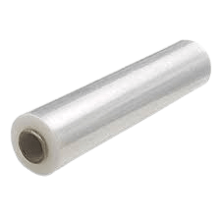
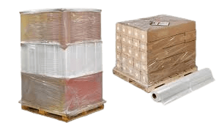
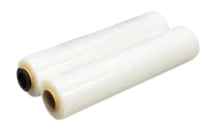
Product Portfolio -Poly
Food Cling Film
Stretch Wrapping Film
Features
Good Strength Regular Usage Easy Use Customized Size
Features
Good Strength Regular Usage Easy Use Customized Size

Slide 18
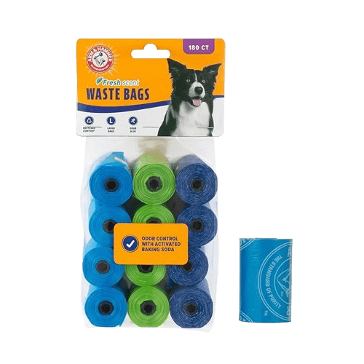
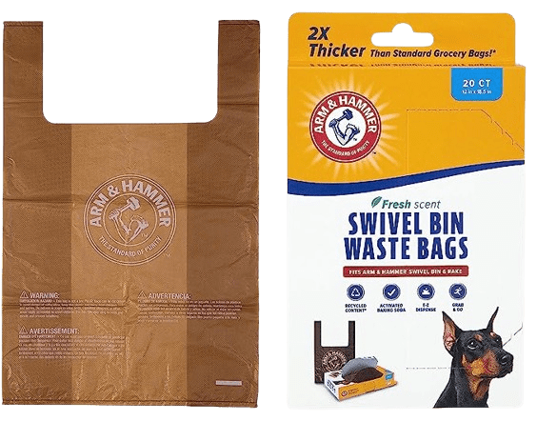
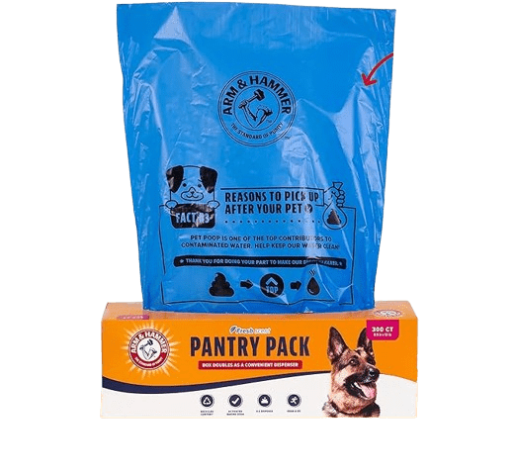
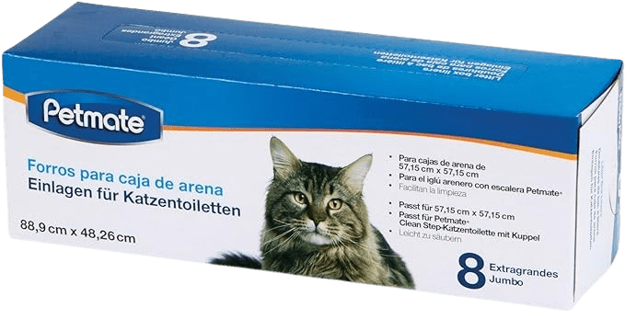
Product Portfolio -Poly
Pet Waste Bag
Easy Tie
Refill Rolls/ Dog Poop Bags
Features
Good Strength Regular Usage Biodegradable Scented/Unscented Compostable Customized Size Aesthetic Design Up to 8 Colors Printing
Liner Bag
Pantry Pack

Slide 19
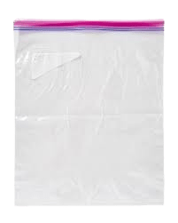
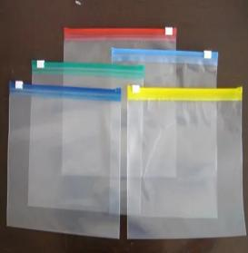
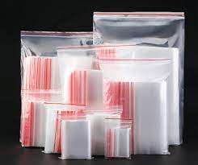
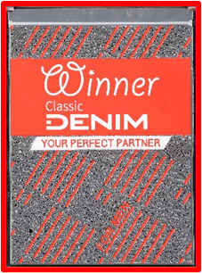
Product Portfolio -Poly
Zipper Bag/Freezer Bag
Features
Good Strength Regular Usage Biodegradable Customized Size Aesthetic Design Up to 8 Colors Printing

Slide 20

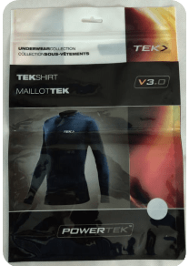
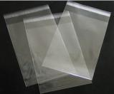
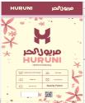


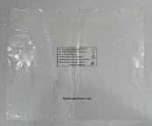
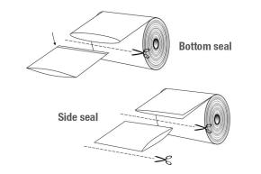
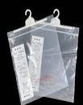
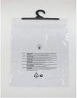
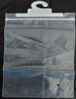
Product Portfolio -Poly
Garments poly Bag
Multilayer
Material: LDPE, PET,BOPP
Side Sealing Bag with Adhesive
Material: PP, LDPE
Poly bag with hanger
Material: LDPE, PET+LDPE, PET+PP
Bottom sealing bag
Material: LDPE, HDPE

Slide 21
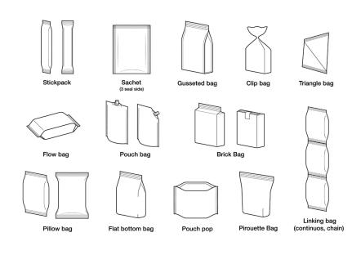
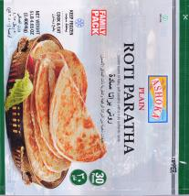

Product Portfolio -Poly
Flexible Packaging
Features
Excellent for high-speed machines. Regular Usage Good moisture barrier properties. High Hot Tack for good sealing on packing machines. Extrusion Lamination for high barrier properties for extended shelf life. Matt, Gloss, Metallic & combinations available.

Slide 22
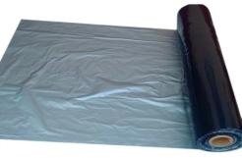
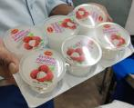
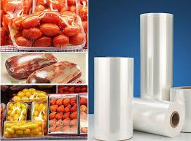
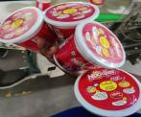

Product Portfolio -Poly
POF Shrink Film
Mulching Film
Features
Uses: Consumer goods, Food and Beverage, Manufacturing Thickness: 10 – 25 Micron Maximum width: 2500mm
Features
Uses: Agriculture

Slide 23




Product Portfolio -Poly
Heat Transfer Film
Hot stamping foil
PVC Door Printing
Ceiling PVC Sheet
Features
Uses: Plastic Decoration
Features
Uses: Door and PVC sheet printing

Slide 24





Tinsel Garland & Décor
Product Portfolio -Poly
Features
Shiny & Vibrant Appearance Flexible & Easy to Shape Lightweight Variety in Style Safe & Non-toxic Material

Slide 25








Product Portfolio: Non-Woven
Non-Woven Collapsible Storage
Material | Pp Non-woven
Production Capacity/Month | 2 Million Pcs/Month
Size & Color | Customized
Print | Flexo & Screen Printing

Slide 26











Product Portfolio: Non-Woven
Non-Woven Storage Container (Developed Designs)
Material | Pp Non-woven
Production Capacity/Month | 2 Million Pcs/Month
Size & Color | Customized
Print | Flexo & Screen Printing

Slide 27




Product Portfolio: Non-Woven
Non-Woven Valentine’s Chair Cover (Developed Designs)
Material | Pp Non-woven
Production Capacity/Month | 2 Million Pcs/Month
Size & Color | Customized
Print | Flexo & Screen Printing

Slide 28




Product Portfolio: Non-Woven
Non-Woven Halloween Chair Cover (Developed Designs)
Material | Pp Non-woven
Production Capacity/Month | 2 Million Pcs/Month
Size & Color | Customized
Print | Flexo & Screen Printing

Slide 29



Product Portfolio: Non-Woven
Non-Woven Storage Bag, Hanging Bag & Scarecrow Chair Cover
Material | Pp Non-woven
Production Capacity/Month | 2 Million Pcs/Month
Size & Color | Customized
Print | Flexo & Screen Printing

Slide 30





Product Portfolio: Non-Woven
Di-cut Bag
T-shirt Bag
Features
Good Strength Customized Size Up to 6 Colors Printing Aesthetic Design
Features
Good Strength Customized Size Up to 6 Colors Printing Aesthetic Design

Slide 31




Product Portfolio: Non-Woven
Tote Bags/ Loop Handle Bag
Sewing Bag
Features
Good Strength Customized Size Up to 6 Colors Printing Aesthetic Design
Features
Good Strength Customized Size Up to 6 Colors Printing Aesthetic Design

Slide 32




Product Portfolio: Non-Woven
Leader Box Bag
V Type Box Bag
Features
Good Strength Customized Size Up to 6 Colors Printing Aesthetic Design
Features
Good Strength Customized Size Up to 6 Colors Printing Aesthetic Design

Slide 33




Product Portfolio: Non-Woven
Lamination Leader Box Bag
Lamination Sewing Bag
Features
Good Strength Customized Size Up to 8 Colors Printing Aesthetic Design
Features
Good Strength Customized Size Up to 8 Colors Printing Aesthetic Design

Slide 34




Product Portfolio: Non-Woven
Non-Woven Fabric Roll:
Non-woven fabrics made-up of compressed PP fibers having much higher puncture resistance, scratch resistance, tear resistance, tensile strength as well aa dart impact strength compared to Ordinary VCI paper.
Uses: Agriculture, furniture, machinery, spare parts packing etc.
FEATURES
For protection of metallic or nonmetallic components.
Coils and CR sheets from adversities of sea humidity.
Storage in open, storage in warehouses for longer periods and other related schemes.
Thermal Bond Dot Fuse Interlining Basically, we are making two types dot fuse interlining. Single dot and double dot including PES, PA coating. this fabrics are used for Jacket, Garments etc .

Slide 35




Product Portfolio: Non-Woven
PP Spun bond Roll Fabric
This type of fabric roll used for carry Bag, Shopping bag, one time Bag, Face mask, Shoe cover, Medical Apron, Laminated Bag, Garments Interlining etc.
Hydrophilic Roll Fabric
This type of fabric used for Baby diaper, Sanitary Napkin, Filter for water solidity etc.

Slide 36







Product Portfolio: Non-Woven
Non-woven Drawstring Bag
This type of bag used for Shoes keeping, any small item/parts keeping.
Medical Gown & Musk
This is used for Medical or Pharmacitical as safety purpose

Slide 37
Capacity & Machines
SL. | Poly M/C Section/Month | NO of Machine | Capacity (MT)
1 | Film Extrusion Section | 112 | 2,600
2 | POF Extruder Section | 1 | 100
3 | T-Shirt Bag Making Section | 16 | 550
4 | Bottom Sealing Section | 32 | 810
5 | Side Sealing Section | 19 | 250
6 | Star Seal Bag on roll | 2 | 25
7 | Wave Top Section | 1 | 20
8 | DIE CUT/Loop Handle Bag Section | 2 | 45
9 | T shirt & Produce Bag on Roll Section | 7 | 100
10 | C-Fold & Star Seal Bag on Roll | 1 | 35
12 | Doggy Poop Roll Bag | 29 | 150
14 | Wicketer Bag | 2 | 25
15 | Draw Tape Trash Bag on Roll | 1 | 30
16 | Flexo Machine Section | 13 | 320
17 | Gravoure Printing Section | 2 | 90
18 | Poly Lamination Section | 1 | 60
19 | Slitting & Re-Winding M/C | 3 | 120
Non-woven Section/Month
M/C Section | NO of Machine | Capacity
Non-Woven Fabric Production Line | 3 | 920 MT
Bag Making | 42 | 680 MT
Sewing Section | 450 | 1000000 PCS
Lamination | 1 | 50 MT
Flexo Printing | 8 | 255 MT
Screen Printing | 2 | 20 MT
Thermal Interlining | 1 | 36 MT

Slide 38



Sustainability
Eco-Friendly Materials
Compostable Bags – 100% biodegradable, certified compostable materials
D2W (Oxo-Biodegradable) Bags – Breaks down faster, reducing plastic footprint
Recyclable Bags – Designed for multiple use and full recyclability
GRS-Certified Recycled Content – Using post-consumer recycled polyethylene & polypropylene
Reduced Carbon Impact – Sustainable manufacturing & raw material sourcing

Slide 39

Sustainability
Environmental Practices
EFFLUENT TREATMENT PLANT
Advance Trims Solution BD LTD commits to eco-friendly & recycled materials, sustainable manufacturing, waste reduction, energy efficiency, and continuous innovation for a greener planet.
RECYCLE PLANT
PLANTATION

Slide 40

Sustainability
Compliance
Oxi-biodegradable
OEKO TEX

Slide 41






ENVIRONMENT FRIENDLY PRODUCTS
BEST PRICE FOR BEST QUALITY
FOCUSED ON COMPLIANCE ISSUE
ON TIME DELIVERY
ZERO DUTY IN EUROPE

Slide 42








Contact Us
Phone
+880 1841 013020
Email
ed.apbl@rflgroupbd.com
Website
https://atsbl.com/
Address
105 Pragati Swarani, Dhaka 1212

Slide 43



We’re ready to serve. Thank you!

